Slide 1
RACO Push-in Cable Connectors

Slide 2
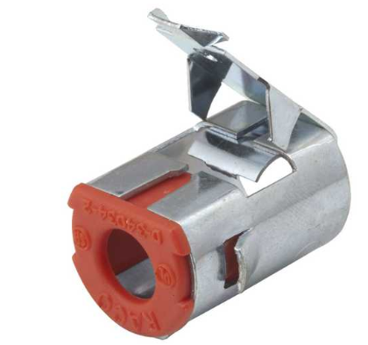
Previous Solution
REDI-LOC®

Slide 3
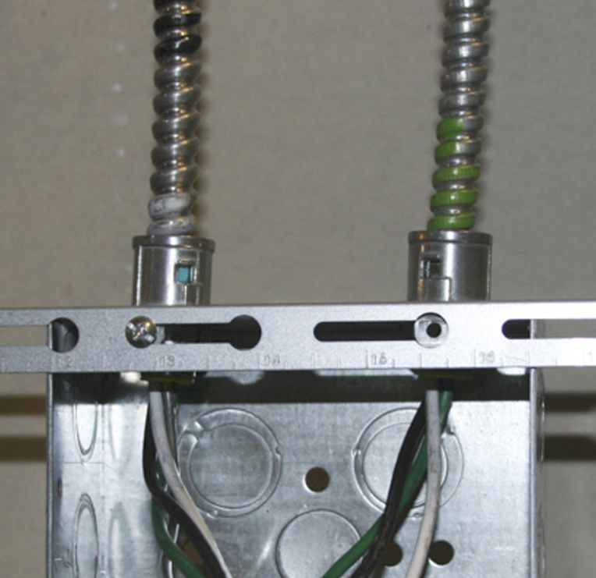
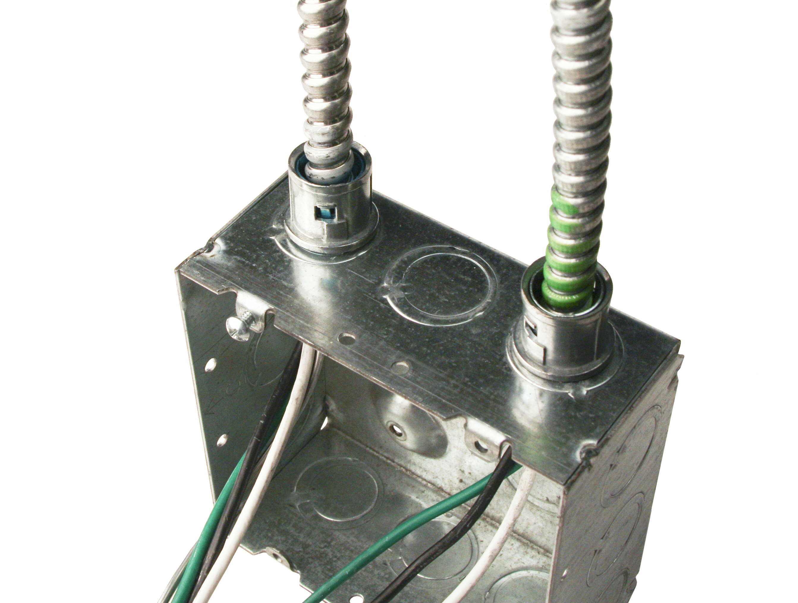
New Solution
RACO’s push-in cable connectors make it easy to secure MC cable into boxes and enclosures
No tools needed
Perfect for new or old work and can be removed and reused

Slide 4
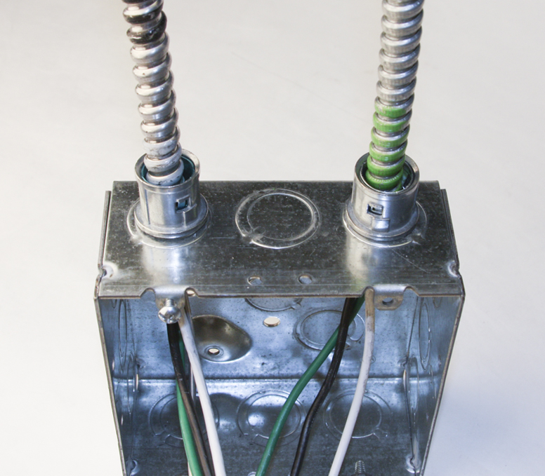
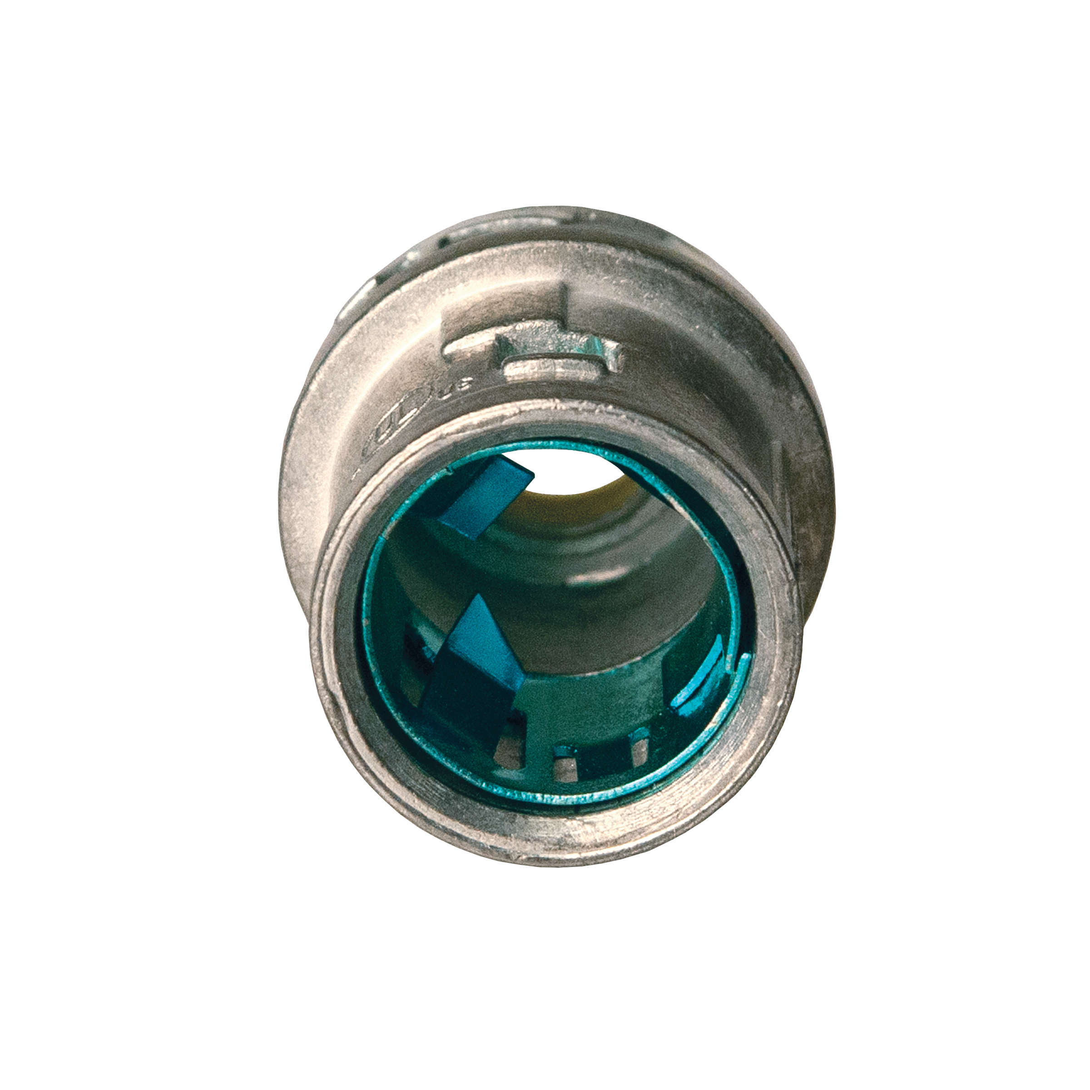
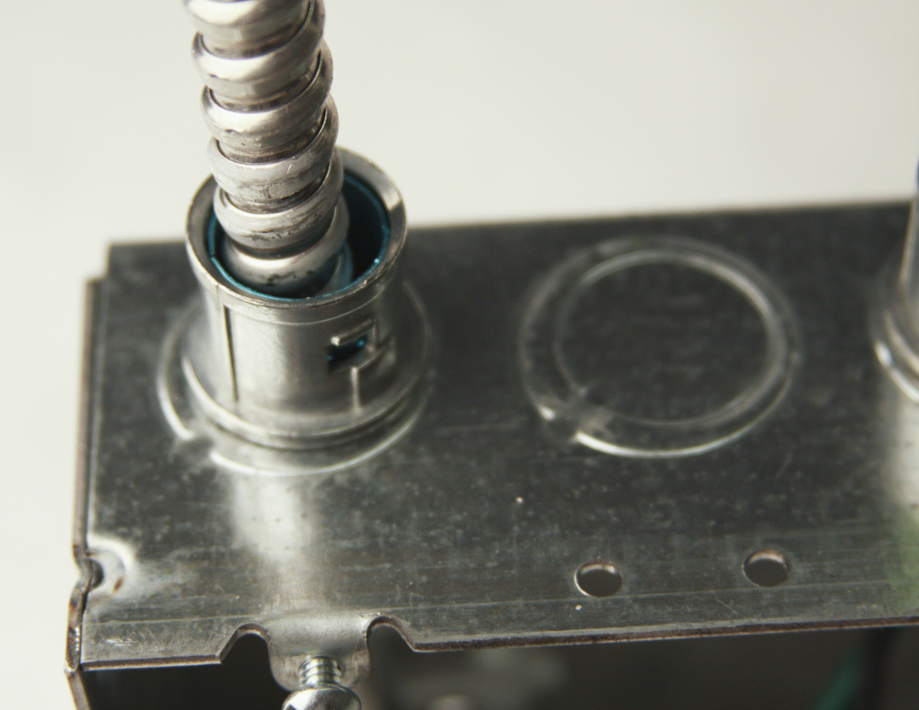
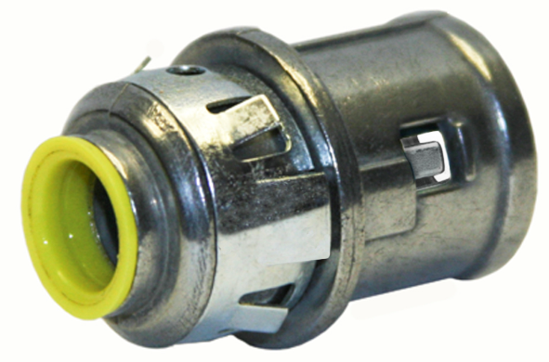
Features & Benefits
Fits standard ½” knockouts
Accepts MC, MCI, MCI-A, AC, HCF, MC-PCS, and Flex
40RAC tinted blue inside to help identify and indicate larger cable range
Die-cast zinc construction with nylon anti-short bushing
cULus Listed

Slide 5
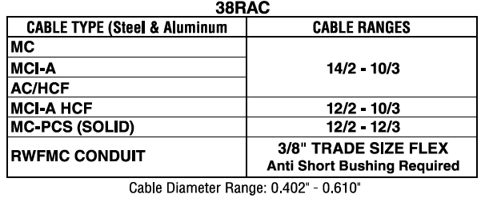
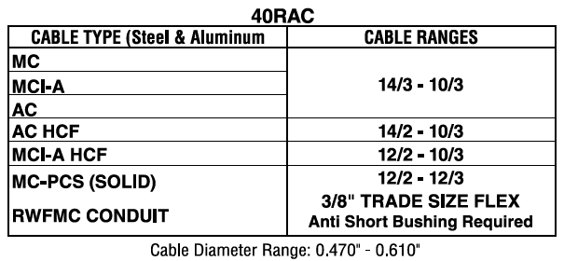
Cable Range Charts
Direct cross
RACO 38RAC = Arlington 38AST
Direct Cross
RACO 40RAC = Arlington 40AST

Slide 6
Removal Instructions

Slide 7
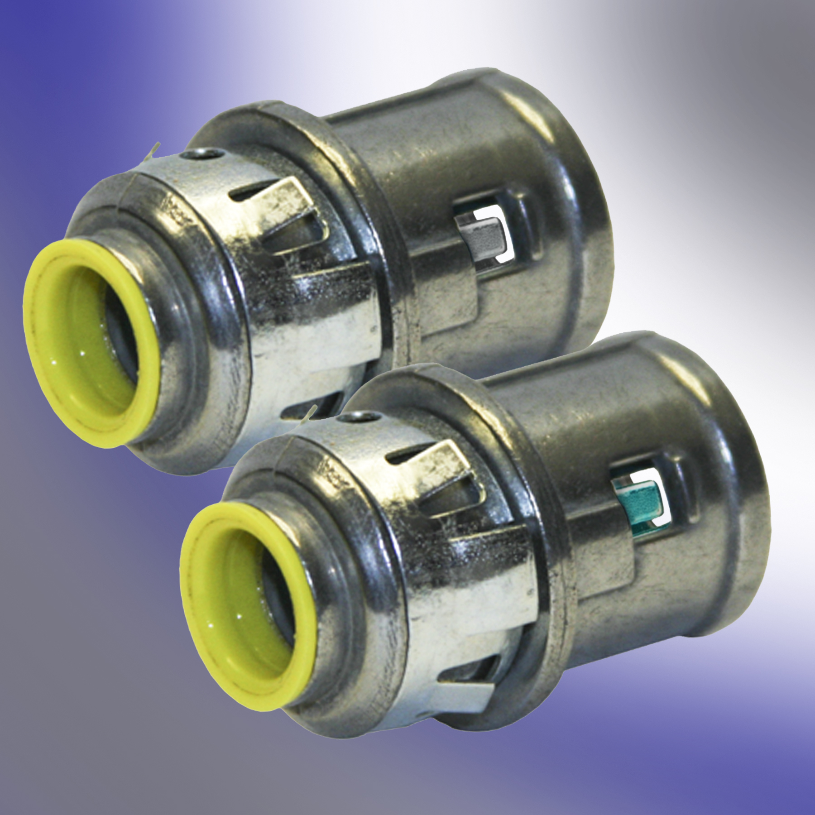
Packaging
IN STOCK
38RAC
40RAC
Unit Carton Qty – 50
Ship Carton - 500
Pallet Qty – 16,000
UPCA – 050169000380
Unit Carton Qty – 25
Ship Carton - 500
Pallet Qty – 16,000
UPCA – 050169000403

Slide 8
Coming Soon
Double Barrel design
3838RAC
4040RAC

Slide 9
Questions?

